Slide 1
Write a PHP script to print prime numbers between1-50
Presented by
Shiva kumar
227R1A05J3
CSE-C

Slide 2


Introduction to PHP
PHP is a powerful server-side scripting language that is widely used for web development and can be embedded within HTML. It provides a range of features and tools that make it a popular choice for creating dynamic, interactive websites and web applications.

Slide 3

What is PHP?
1
Open-Source
2
Server-Side
PHP is an open-source language, meaning it is freely available and can be modified and distributed by anyone.
PHP code is executed on the server, allowing for the creation of dynamic web pages and applications.
3
Versatile
PHP can be used for a wide range of web development tasks, from simple scripts to complex enterprise-level applications.

Slide 4
PHP Syntax and Structure
Syntax
Structure
Case Sensitivity
PHP syntax is similar to other programming languages, with the use of variables, functions, and control structures like if-else statements and loops.
PHP code is typically organized into files, with each file containing a mix of HTML and PHP code. The PHP code is enclosed within special tags, such as .
PHP is case-sensitive, meaning that variable names, function names, and other language constructs must be written exactly as they are defined.

Slide 5

Printing Prime Numbers in PHP
What are Prime Numbers?
Importance of Prime Numbers
Prime numbers are positive integers greater than 1 that are only divisible by 1 and themselves.
Prime numbers have many applications in fields like cryptography, number theory, and algorithm design.
Printing Prime Numbers in PHP
We can write a PHP script to print all prime numbers within a given range, such as 1 to 50.

Slide 6

Prime Number Algorithm Explanation
1
Check Number
Start by checking each number in the given range, starting from 2.
2
Divisibility Test
Check if the number is divisible by any number between 2 and the square root of the number.
3
Print if Prime
If the number passes the divisibility test, it is a prime number and can be printed.

Slide 7
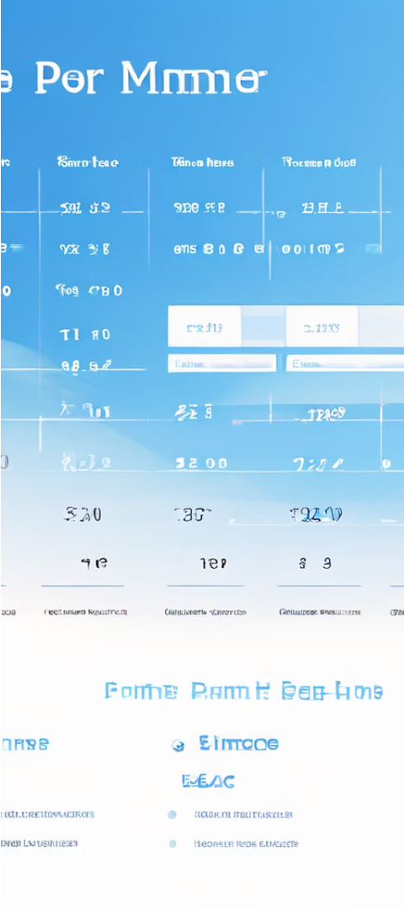



PHP Script to Print Prime Numbers (1-50)
Initialize
Start with the range of numbers from 1 to 50.
Check Divisibility
For each number, check if it is divisible by any number between 2 and the square root of the number.
Print if Prime
If the number passes the divisibility test, print it as a prime number.

Slide 8
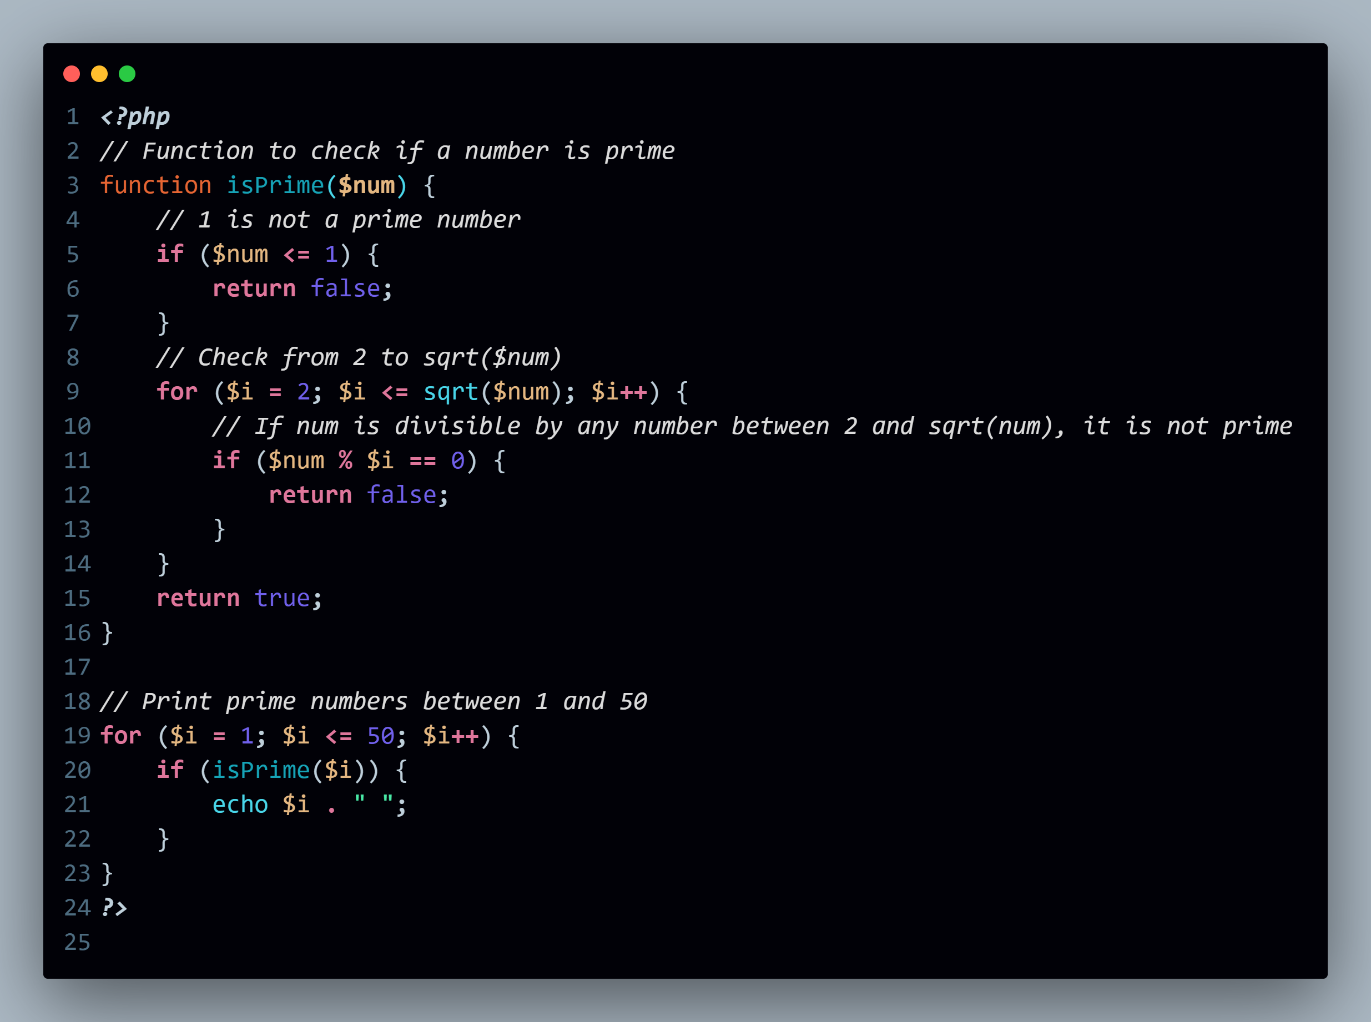

Slide 9
Conclusion and Key Takeaways
PHP is a powerful, open-source server-side scripting language for web development.
Prime numbers are integers greater than 1 that are only divisible by 1 and themselves.
A PHP script can be used to print all prime numbers within a given range.
Prime numbers have important applications in fields like cryptography, algorithm design, and number theory.

Slide 10


